Slide 1


Notes:
Closing Slide #1

Slide 2
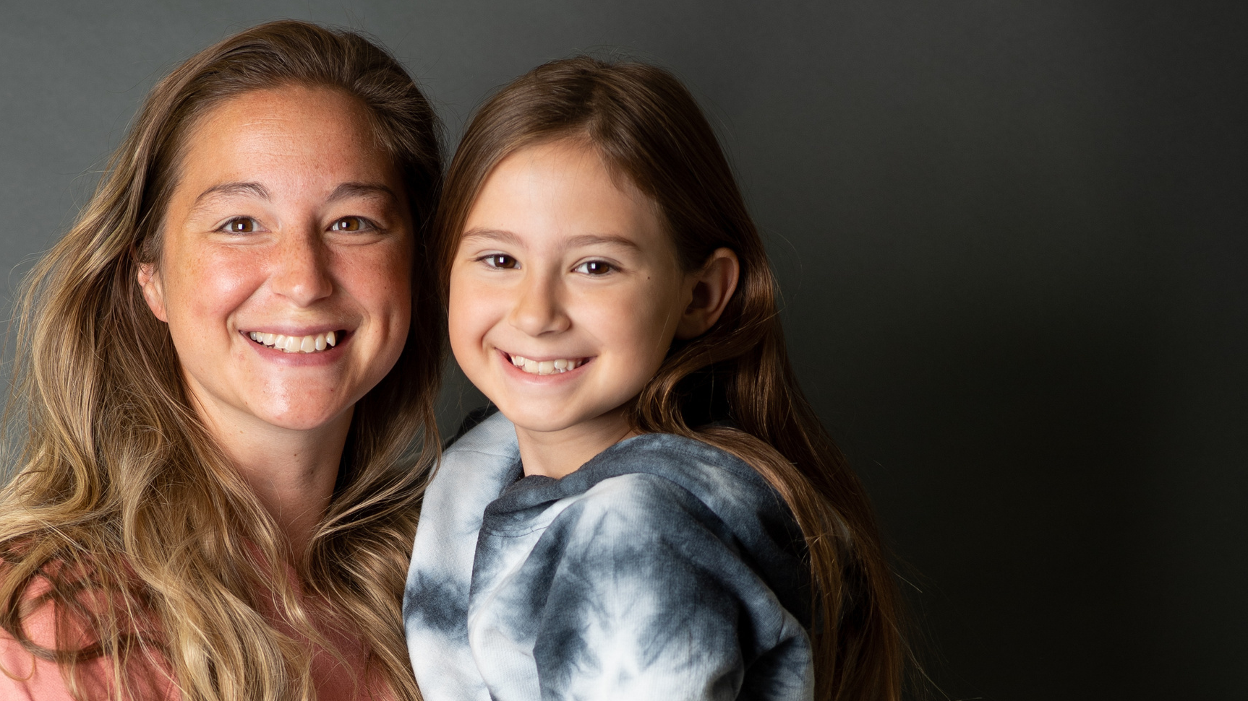
WE BELIEVE HUNGER IS UNACCEPTABLE AND THAT OUR COMMUNITY HAS
THE POWER TO CHANGE LIVES — ONE MEAL AT A TIME.
Notes:
Belief

Slide 3

WE ENVISION A COMMUNITY IN WHICH
ALL NEIGHBORS ARE NOURISHED AND EMPOWERED WITHIN
AN EQUITABLE FOOD SYSTEM.
Notes:
Vision

Slide 4
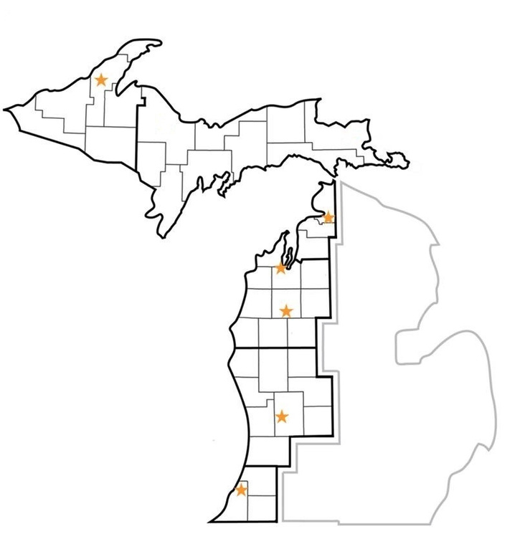






Where We Work
7
40
large-scale distribution
centers
83
of
More than
1/2
counties
of the state
geographically
7
700+
urban
33
rural
food pantry and
meal program partners
Notes:
Service area

Slide 5

Hunger in West Michigan and the U.P.
293,500
64,880
PEOPLE
CHILDREN
1 in 8
12%
PEOPLE
POPULATION
26%
ASSET LIMITED
INCOME CONSTRAINED EMPLOYED
ALICE
Notes:
Hunger in our service area

Slide 6

Local Food Insecurity in 2021
ALL RESIDENTS
ALL CHILDREN
Kent County
68,860 (10.6% or 1 in 9)
Ottawa County
25,700 (9% or 1 in 11)
Muskegon County
23,060 (13.3% or 1 in 8)
Kent County
15,390 (9.7%or 1 in 10)
Ottawa County
4,440 (6.4% or 1 in 16)
Muskegon County
6,310 (15.6% or 1 in 6)
The USDA defines food insecurity as a lack of consistent access to enough food for an active, healthy life.
Notes:
Hunger by region

Slide 7

What is the same this summer?
Promotional Material
Site Visits
Food Distribution Processes
Premiums
Notes:
Content #1 Slide – great for light content, statements, and facts.

Slide 8
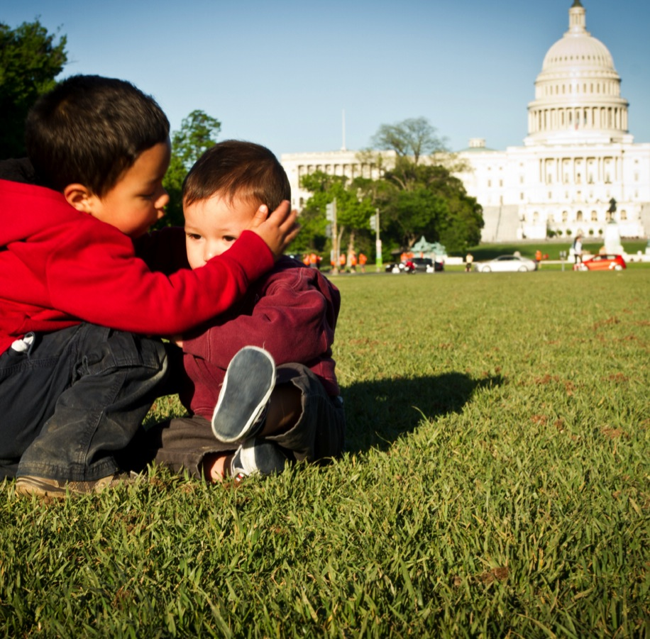
What’s different about this summer?
New Reporting Methods
New Account Agreements
Program Manual
Increased Exposure
Bulk Meal Distribution*
Notes:
Content #1 Slide – great for light content, statements, and facts.

Slide 9

Forms
WHAT DO I NEED THIS SUMMER?
Notes:
Level 1 Divider Slide

Slide 10
What forms are we using this summer?
Partner Site Agreement
Policies and Procedures
Daily Meal Count Sheets
Meal Order Forms (Electronic)
Meal Menus
Electronic Reporting
Notes:
Content #1 Slide w/ customizable photo
Great for light content, statements, and facts.

Slide 11

Daily Food Service
WHAT DOES A NORMAL DAY LOOK LIKE?
Notes:
Level 1 Divider Slide

Slide 12

Steps you should follow each day
Check inventory
Select Meals (Max 2 per Day)
Post Menu
Ensure Food Area is Clean
Gather Meal Count Sheets
Serve Food
Clean Up
Re-Check Inventory
Enter Daily Count Sheet Info Electronically
Notes:
It’s important to start on time. Kiddos and parents will be looking at your posted hours and planning when to come based on that.

Slide 13

Getting Your Food
ORDERING AND PICKING UP YOUR MEALS
Notes:
Level 1 Divider Slide

Slide 14

How and when do I order meals?
PWW Online Ordering
3 Working Days Prior to Pick-Up/Delivery (LP)
5 Working Days Prior to Delivery (UP)
Depot Pick-Ups – Pre-Arranged
Pick-Up During Designated Time
We cannot accommodate emergency orders or door-to-door deliveries
Order a variety of meal types – Playing favorites will come back to bite you
Make sure you can transport the volume of meals you order
Some depot delivery dates and cut-offs shift due to holidays or layout of the month
Notes:
Content #1 Slide w/ customizable photo
Great for light content, statements, and facts.

Slide 15
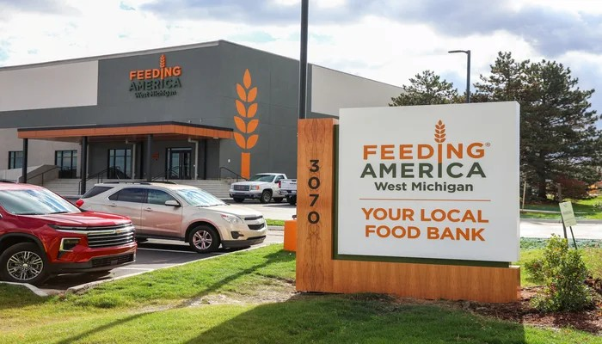
Picking Up Meals at the Warehouse
Pull Up to Assigned Door (7,8,9)
Come Through Agency Pick-Up Door
Check In At Desk
Provide Your Agency Number to Agency Representative
Walk Over to Door Inside and Open It
Do Not Leave Without Signing Your “Invoice”
Keep Your Copy for Your Records

Slide 16
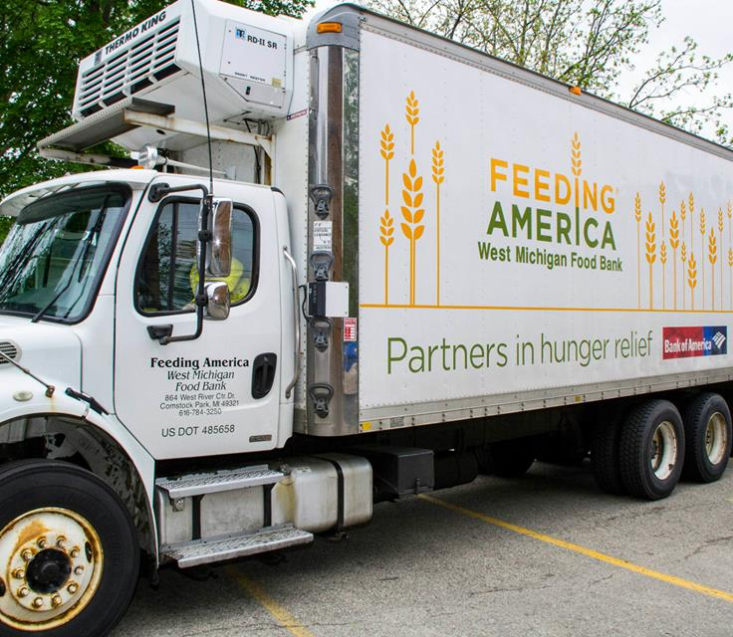
Picking Up Meals at a Depot
Park at Depot Site
Check-In With Driver
Provide Them With Your Agency Name and Number
Collect Your Order
Do Not Leave Without Signing a Copy of Your “Invoice”
Keep Copy For Your Records

Slide 17
Electronic Reporting Demo
Notes:
Level 2 Divider Slide
To Change the Footer:
Go to the toolbar and click View, select Master, select Slide Master.
Make sure you are on the first slide.
Edit the footer.
Save, and return to Normal view (click View, click Normal).

Slide 18

Providing People the Best Experience Possible
Food Safety and civil Rights

Slide 19

The safety of the kiddos we serve is the top priority.
Food is shelf-stable
Should be stored 4-6 inches off the ground
Dry, cool place
Intact room, free of pests or debris
Keep track of damaged meals
“When in doubt, don’t hand it out”
Notes:
Content #2 Slide – Best for medium levels of content, with photos.

Slide 20



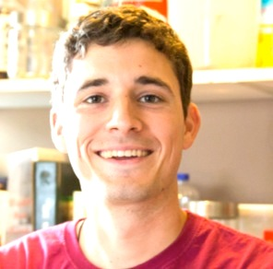
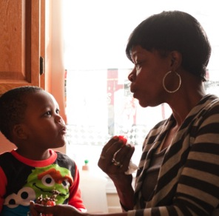



Providing a safe, equitable, and dignified experience is our goal.
Serve all who attend
Take people at their word
No proof of income, residency, status, etc. is required or should be asked for
No racial or ethnic data will be collected
Honor and lift client’s voices regarding their needs
Take note of gaps in service related to culture and experience
Notes:
Content #1 Slide – great for light content, statements, and facts.

Slide 21
Something worth mentioning…
Notes:
Level 2 Divider Slide
To Change the Footer:
Go to the toolbar and click View, select Master, select Slide Master.
Make sure you are on the first slide.
Edit the footer.
Save, and return to Normal view (click View, click Normal).

Slide 22

TOGETHER
WE CAN
SOLVE
HUNGER
Notes:
Title slide for presentations where partner has a logo

Slide 23



Shay Kovacs
Programs Manager
(616) 432-6966
ShayK@FeedWM.org
Conrad Cuncannan
Programs Coordinator
(616) 295-8190
ConradC@FeedWM.org
Notes:
Closing Slide #2

